Slide 1


Slide 2
WHEN FOOD IS WRONG ,
MEDICINE IS OF NO USE
AND
WHEN FOOD IS RIGHT,
MEDICINE IS OF NO NEED

Slide 3
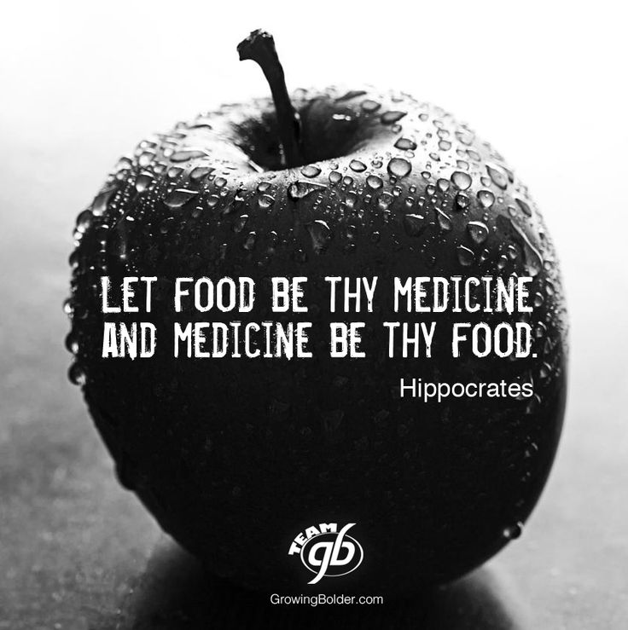
It was Hippocrates who in 400 B.C. attributed, diet (Nutrition) in relation to disease.

Slide 4
BALANCED DIET
Defined as one which contains different types of foods in such quantities and proportions, that the need for the energy, amino acids, fats, carbohydrates, minerals, vitamins and other nutrients, is adequately met for maintaining health, vitality and general well being and also makes small provisions for extra nutrients to withstand short duration of leanness.

Slide 5
NUTRIENTS - CLASSIFICATION
There are 6 essential nutrients that are necessary for the body to function properly
MACRO NUTRIENTS : Nutrients required in large quantity, constitute proximate principles, they form main bulk of the food
Carbohydrates
Proteins
Fats
MICRONUTRIENTS: Nutrients required in small quantity
Vitamins
Minerals
Water ,helps to maintain homeostasis in the body and transports nutrients to cells. Water also assists in removing waste products from the body.

Slide 6
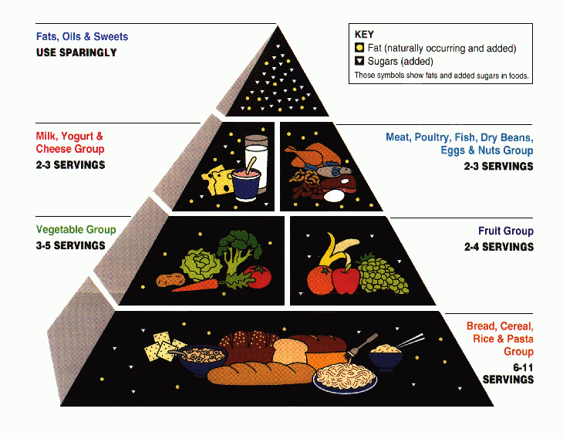

Slide 7
BREAK FAST – Most important meal of the day
Kick start your day with a nutritious breakfast. It will help you perform better at work and give you the energy you need to get through the morning
Eating a morning meal has many health ramifications. It is important to "refuel" your body
after not eating for many hours during the night.
Breakfast provides the glucose that is the primary energy source for the body and the brain.
Gail Frank of the American Dietetic Association states that "Breakfast skippers often feel tired,
restless, or irritable in the morning" (American Dietetic Association 2004).
The brain's functions are very sensitive to changing glucose levels. Research has also shown
that missing this meal diminishes the mental performance of children, young adults, and the
elderly.
Simple meals such as whole-grain cereals, fresh fruits, and eggs can be prepared easily and
quickly. These kinds of foods also provide energy and many nutrients needed to stay healthy.

Slide 8
LUNCH
At lunch time, eat a substantial meal to fuel you for the afternoon but make sure that it isn’t too heavy. Essentially, it should be a medium-sized meal – smaller than breakfast but larger than dinner.
DINNER
If you eat a large meal at dinner, which is traditional in most homes, weight gain can occur as the body cannot use all the energy in the food and thus stores it as fat instead. A heavy meal at dinner can also cause sleep disturbances.
We need the most energy at the beginning of the day, and the least energy at the end, when most daily tasks are over and we are relaxing. Eat according to the needs of your day.
If you have an office or other sedentary jobs, eat lighter meals
If your job is more active, eat foods that provide sustained energy.

Slide 9
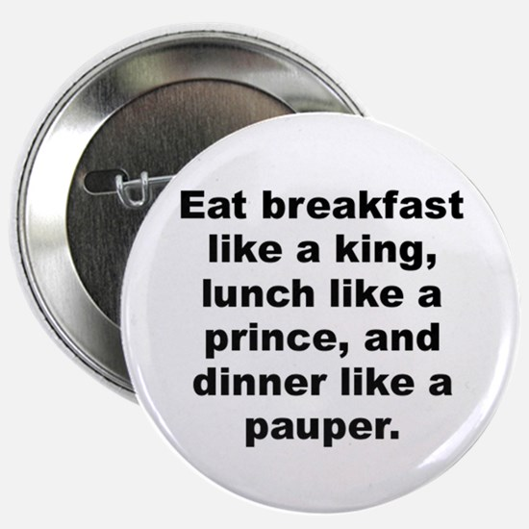
High-calorie breakfast with reduced intake at dinner is beneficial

Slide 10
Everything you eat and drink over time matters. The right mix can help you be healthier now and in the future. Start with small changes to make healthier choices you can enjoy. Find your healthy eating style and maintain it for a lifetime. This means:
● Make half your plate fruits and vegetables. ○ Focus on whole fruits. ○ Vary your veggies. ● Make half your grains whole grains. | ● Move to low-fat and fat-free milk or yogurt. ● Vary your protein routine. ● Drink and eat less sodium, saturated fat, and added sugars.
LUNCH

Slide 11
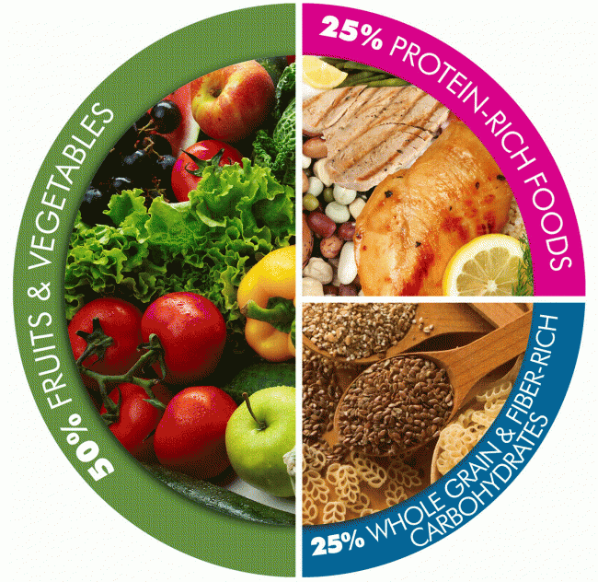
MY PLATE

Slide 12
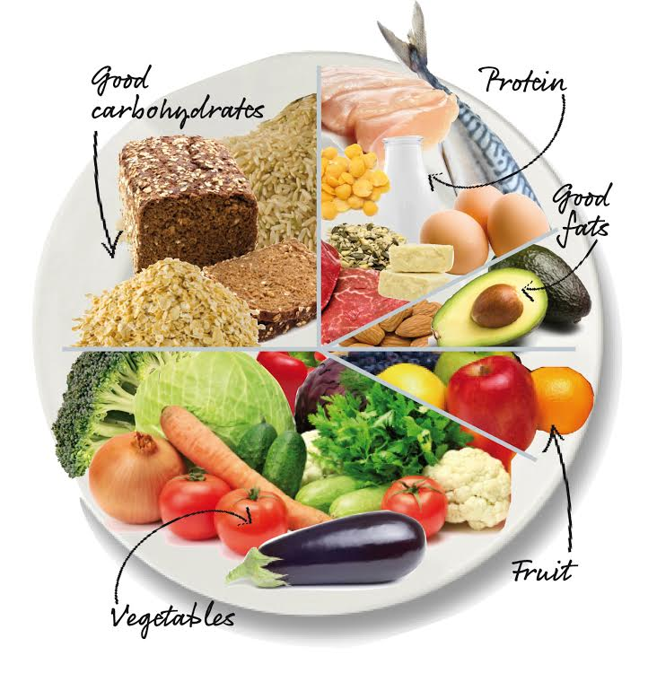
Dilute the calorie density of your meals by filling ½ of your plate (visual volume)
with intact whole grains ,starchy vegetables and or legumes
and
other half with non starchy vegetables and fruits
Intact Whole grains
Brown rice
Whole wheat
Quinoa
Starchy Veggies
Potatoes
Yam
Legumes
Beans(rajmah/cholae)
Lentils
Peas
Fruits
Citrus
Melons
Berries
Non- starchy veggies
Cruciferous
Green leafy

Slide 13
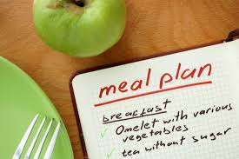
Having a smart eating mindset
* Making easy everyday food choices that
benefit your health
* Buying right-for-you foods
Eat a variety of nutritious foods from all the
food groups
Eat an overall healthy dietary pattern that emphasizes : a variety of fruits and vegetables,
whole grains,low-fat dairy products, skinless poultry and fish nuts and legumes
Cut back on beverages with added sugars
Use up at least as many calories as you take in – Physical activity at least 45 min each day

Slide 14
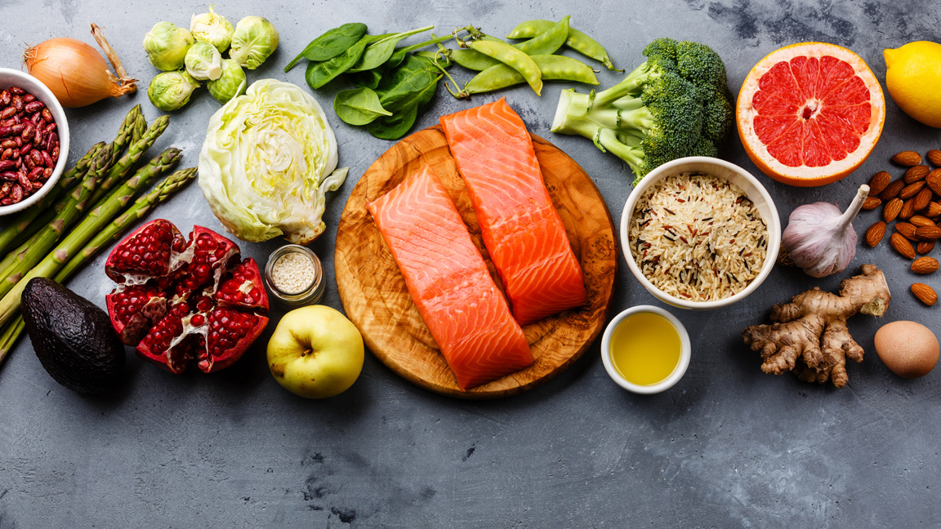
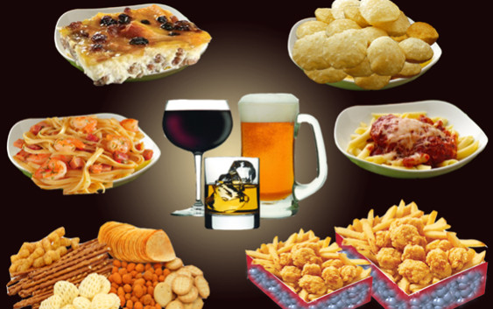
CALORIE DENSE / NUTRIENT DENSE
A Food that contains a high amount of nutrients than calories – Nutrient Dense
Foods that contain more vitamins, minerals in relation to their fats, sugar content
A Food that contains low amount of nutrients than the calories you take – Calorie dense
Foods that contain more sugars, saturated and trans fat and alcohol

Slide 15
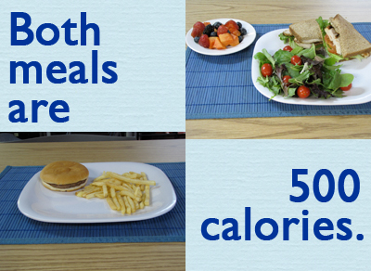
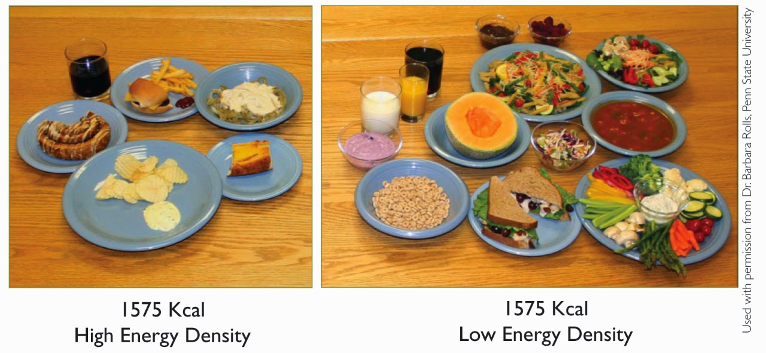
DON’T COUNT CALORIES COUNT NUTRIENTS
AS OUR
BODY REQUIRES
NUTRIENTS NOT CALORIES

Slide 16
HOW TO MAKE FOODS NUTRIENT DENSE ?
Choose variety of grains and pulses (Quinoa, brownrice,
Wholewheat, jowar, Bajra, millets, Barley, Flax seeds)
Add cut fruits to your oats / cereal instead of sugar
Add dry fruits and nuts
Prefer fresh fruits instead of juices
Choose variety of colorful vegetables , green leafy and salads
as a rainbow

Slide 17
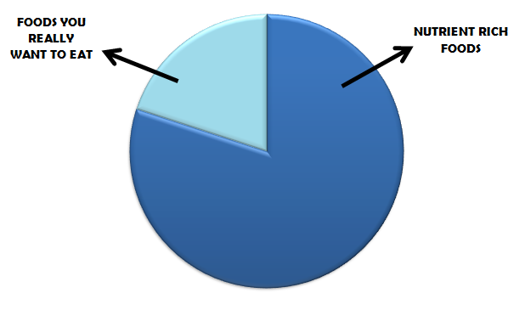
Plan healthy snacks like
Variety of salads
Boiled seasoned sprouts
Corn
Wheat bread sandwich with a slice of cheese and lots of veggies
Bhel with grated vegetables
Fresh cut fruit
cut down simple sugars , saturated fats

Slide 18
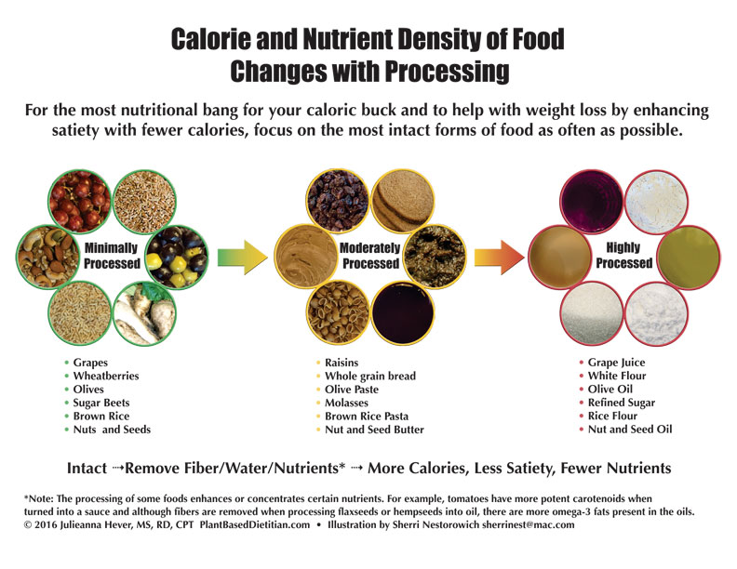

Slide 19
Summer Nutrition Tips
Drink plenty of water – be well hydrated
Water keeps the body cool and prevents dehydration. It also helps one avoid putting on unnecessary calories. Fresh lime juice and coconut water is also a great thirst-quencher, especially during summer.
Avoid aerated drinks
Have plenty of fresh fruits and vegetables – Include 5 servings in a day
2 servings of fresh fruits – Fruit milk shakes and smoothies are best options
Just add some fruits and milk in a blender and your healthy snack is ready
Try innovative salads to be included in the diet which are tasty option
Eating a lot of fresh salads during the summer months is a great idea because salads are easy to prepare and are healthy for your body but keep a check on the dressings
Curd and yogurt are other options –delicious and healthy options
They help to keep us hydrated , butter milk with added mint / lemon to enhance taste
is good option

Slide 20
Don't skip any meals
People drastically lose weight by cutting down on meals, but this is very unhealthy
and might have adverse affects.
Skipping meals also slows down the metabolism which means the body burns fewer
calories.
Stay away from
Aerated drinks / coffee / tea All these drinks contain preservatives, colours and
sugars.
Restrict the amount of salt and sugar
Cut the intake of fried foods, like vadas, samosas, chips, bhajias, etc. Fat has a
thermal effect.
Prefer fresh foods
During summer food gets spoiled quickly so prefer freshly prepared foods and pay special attention to freshness of meats

Slide 21
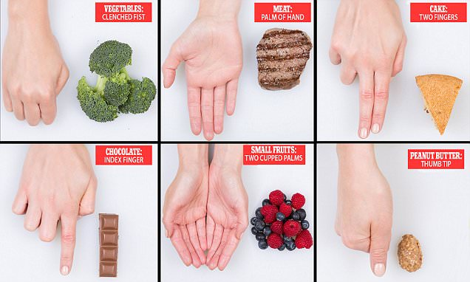
HOLIDAY HEALTHY EATING
You can eat healthy and be well this holiday season by following simple strategies
Eat in Moderation ( Portion size matters ) , enjoy holiday treats in small portions and make healthy substitutions wherever possible

Slide 22
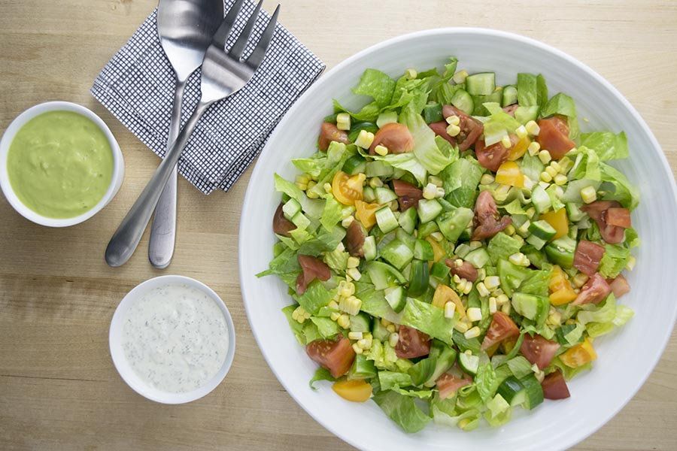
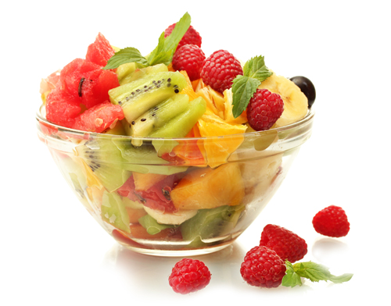
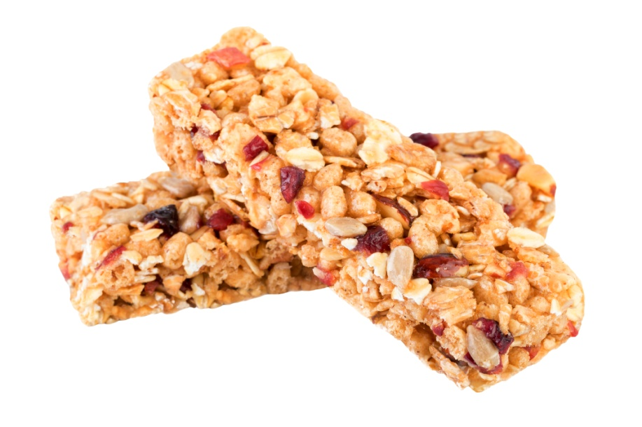
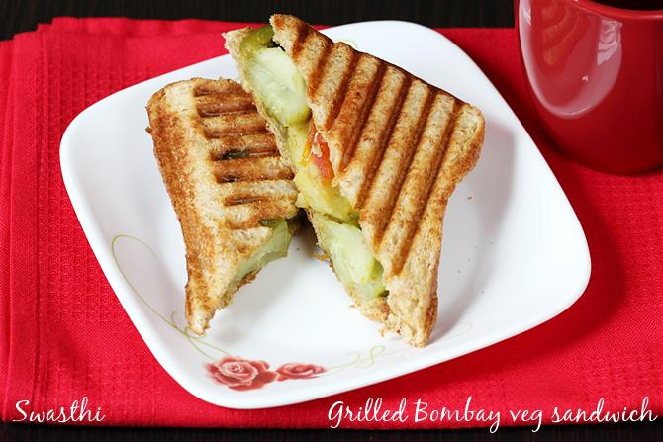
Fill your plate with lots of colorful seasonal fruits and vegetables which will add
flavor, color and nutrients too.
Plan ahead – have a healthy snack before hand such that u can resist on in a buffet treat

Slide 23
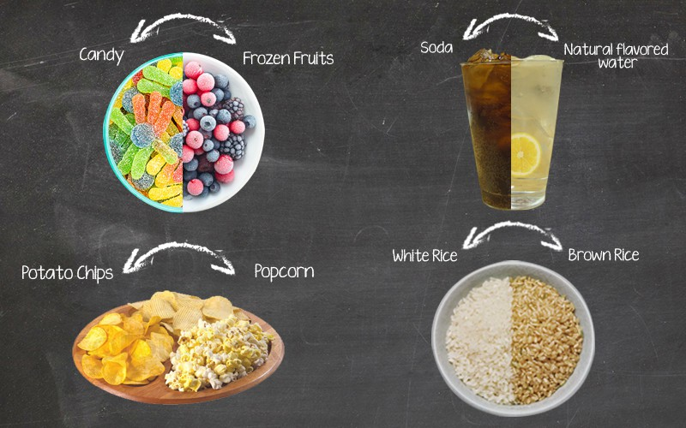
Cut down on unwanted calories with health swaps and substitutions

Slide 24
Don’t eat while watching TV or a movie or when you’re on the computer.
It’s harder to control how much you’re eating if you don’t pay attention to what you’re putting in your mouth, and when and how much.
Filter your water and put it in a bottle and carry around
Coconut water is extremely refreshing
Cut down on sugars which gives empty calories
Using a food diary can help you pay closer attention to what you're eating, how much and how often.

Slide 25
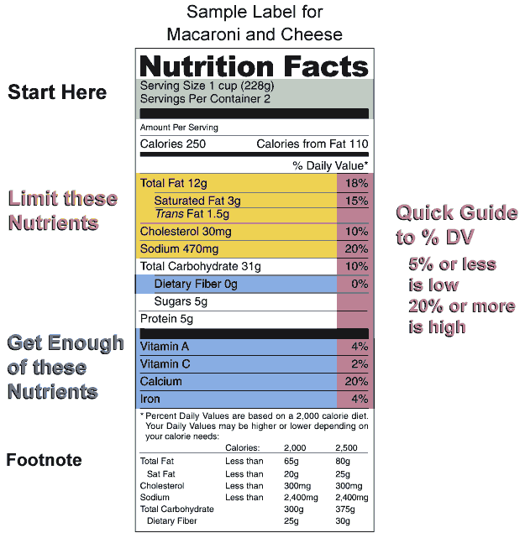
START
READING
NUTRITION FACT
LABELS

Slide 26
Pay attention to serving size – How many serving in food package
The number of servings you consume determines the number of calories you actually eat
How many calories are from fat
Limit these nutrients – Saturated fats , Trans fats , Cholesterol and sodium – Eating too much of these nutrients may increase your risk of certain chronic diseases
Get enough of – Dietary fiber, vitamin A, Vitamin C , Calcium , Iron to improve health
% DV( Recommended daily values) are based on 2000 calorie diet and varies for each person5% or less is low
And 20 % or more is high
Sugars listed on label include naturally occurring sugars as well as those added to a drink / food
Ingredients are listed in descending order of weight from most to least
If you are concerned about your intake of sugars make sure that added sugars are not listed among the first few ingredients ( Corn syrup, High fructose corn syrup, Fruit juice concentrate, Sucrose , maple syrup)

Slide 27
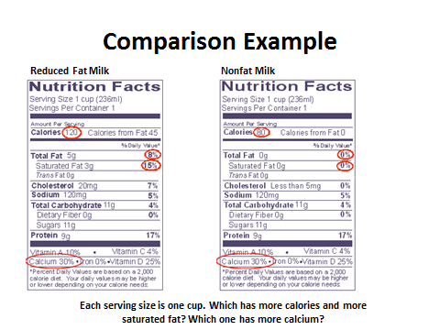
Shop wisely
Keep away from preserved and packaged food
Dairy, Poultry, Fruits Veggies should be the priority
Choose quality nutrient dense foods
Buy foods that are right for you
Plan in advance for the week ahead and choose variety
foods
Invest in grab and go snacks like nuts / granola bars
Go shopping with a detailed grocery list
Never go shopping on an empty stomach

Slide 28
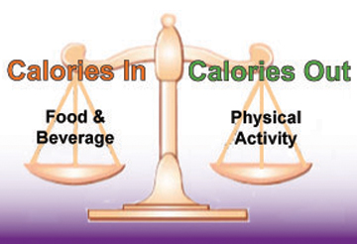
PHYSICAL ACTIVITY
Control your weight
Reduce your risk of cardiovascular diseases
Reduce your risk of metabolic syndrome and some cancers
Strengthen your bones and muscles
Improve your mental health and mood
Improve your ability to do daily activities
Everyone can gain the health benefits of physical activity – age, ethnicity, shape or size do not matter.

Slide 29
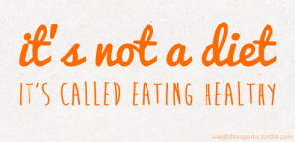
The best investment you can ever make
is in Your own health
SWETHA ANISINGARAJU

