Slide 1
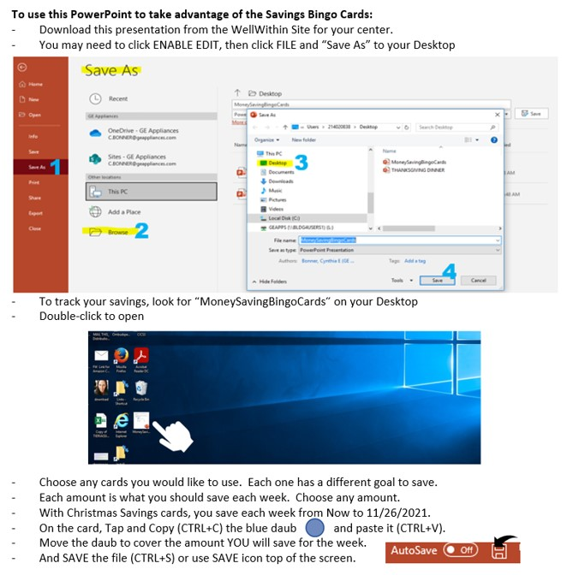

Slide 2



Slide 3


Slide 4


Slide 5


Slide 6


Slide 7
I'm an extra daub if you need me.
Copy me and paste me wherever you need me.

